Slide 1

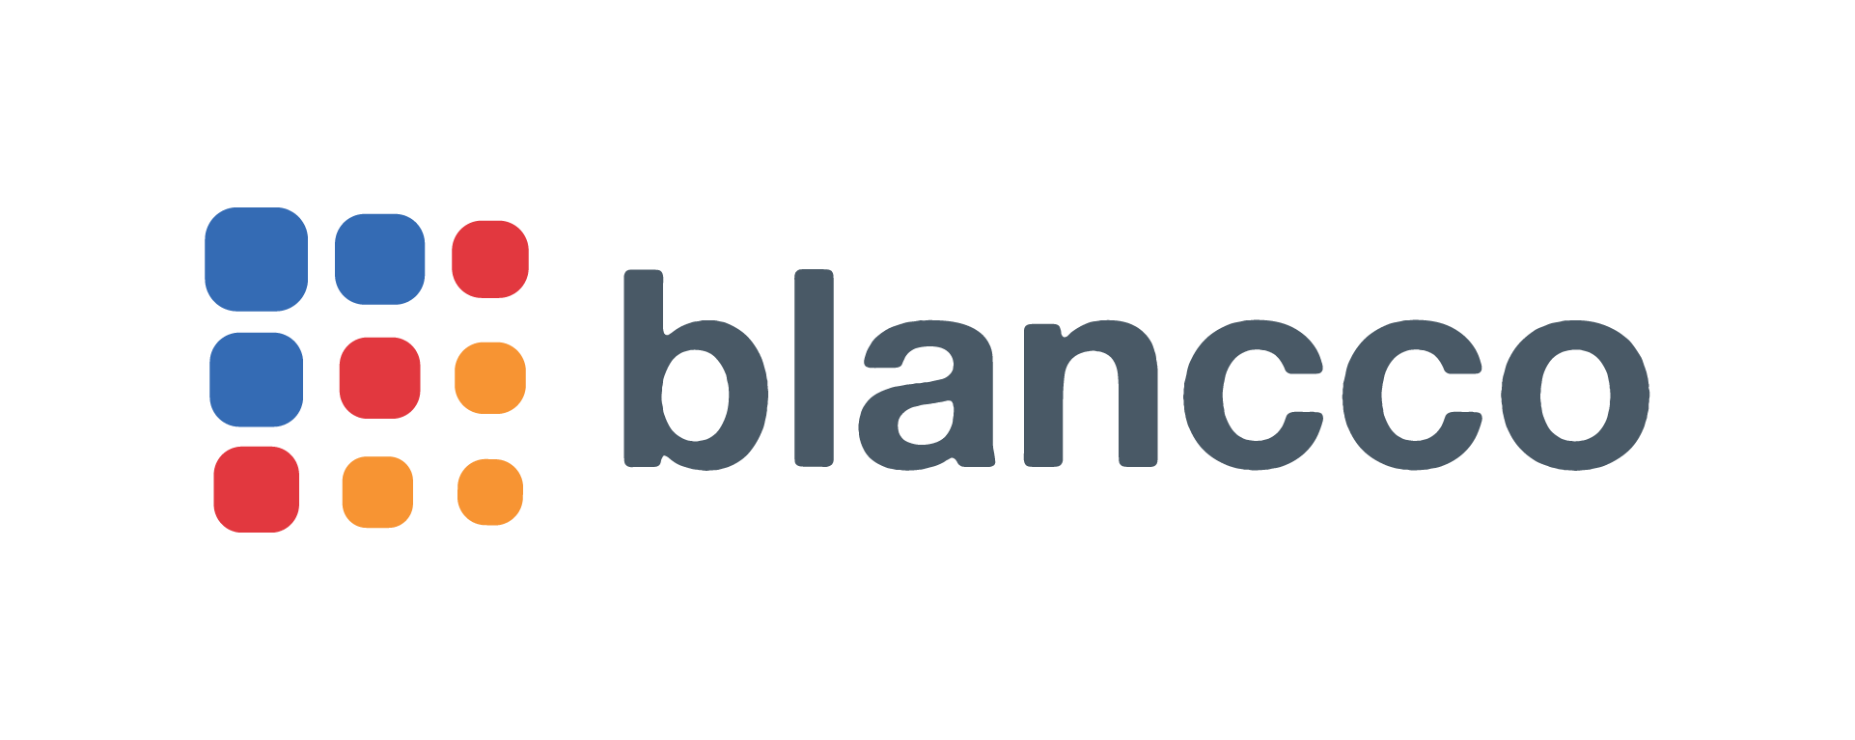
Data Center
Erasure Solutions
Making the Case

Slide 2

  Data Erasure
  Data erasure is the software-based method of securely overwriting data from any data storage device using zeros and ones onto all sectors of the device. By overwriting the data on the storage device, the data is rendered unrecoverable and achieves data sanitization.
Includes verification & certification with every erasure
Supports environmental initiatives
Allows organizations
to retain the resale value
of the storage devices
Blancco Proprietary & Confidential. Do Not Copy or Distribute. Copyright © 2018 Blancco Oy Ltd. All rights reserved.
2
2

Slide 3
Enterprise Data Centers Must Document and Enforce Compliant Operations
External Compliance
Internal Compliance
Data protection laws & regulations
Corporate auditors
Customer demand
Corporate security policies
Environmental responsibilities
Requirement for new customer acquisition

Slide 4



When to Perform Data Erasure in the Enterprise
Customer Demand
The Right to be Forgotten allows EU citizens to request removal of their data from your system.
Data Migration
When data is moved from one location to another, from an old server to a new one, or virtual machine to another – the original data location must be erased.
Employee Onboarding & Departures
Protect against data breaches at transition points in your hardware’s chain of custody and use.
Disaster Recovery Exercises
Following the successful restoration of production systems, any data left on the recovery disks should be erased.
Equipment End-of-Life
When a server, storage, device or other IT asset is ready to be reused, resold or discarded – any data must be erased.
Cloud Exit
When you are exiting a cloud service or
a managed services provider is handling your data, data erasure policies must still be enforced to keep control over the data.
Data End-of-Life
When data is no longer needed on any storage device, policies can enforce the erasure of virtual machines, files and folders with automated routines within your existing systems.
Notes:
So when should you absolutely use data erasure? These are some of the most common ways – although it is important for us to do a thorough analysis of your current infrastructure to determine gaps and how erasure could fill those gaps.

Slide 5





In the Data Center: Meet Security and Compliance Without Compromising Operational Efficiency
A Data Center Erasure Solution Must:
+
+
+
+
Handle high-volume, high capacity needs as they consolidate and allocate bandwidth
Be operating system and manufacturer agnostic so you don’t have to change your environment
Provide an audit trail on every asset of compliance in order to meet corporate security policies
Automate the process to reduce human error
Certifiably erase all drive types to maximize performance and increase efficiency

Slide 6
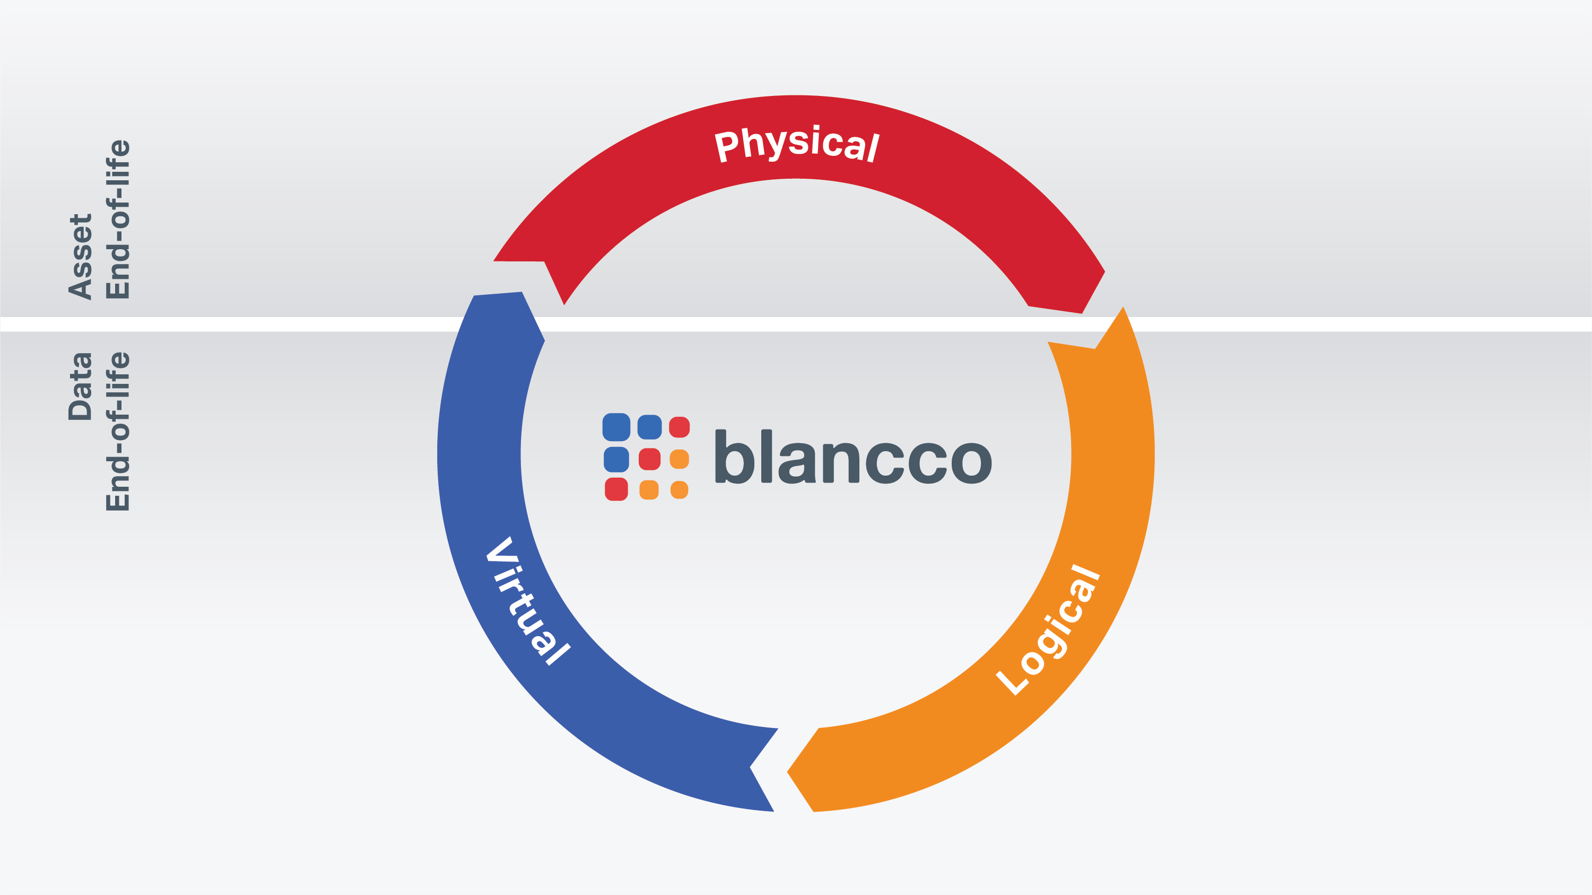
Physical Level: Servers, Drives, etc.
Server decommissioning
Tech refresh
End of lease
Return test systems
Break-fix (RMA)
Data migration
Customer Exit- Cloud Exit
VM lifecycles
Repurposing system storage
Temporary data
Data retention policies
Virtual Level: VMs, vApps, etc.
Logical Level: LUNs, SANs, Files, etc.
Notes:
Physical level:
Drive eraser to target the entire physical drive
Logical/virtual:
Increasing awareness and demand where we erase on the logical level (we can’t capture serial drives numbers or NIST purge)

Slide 7
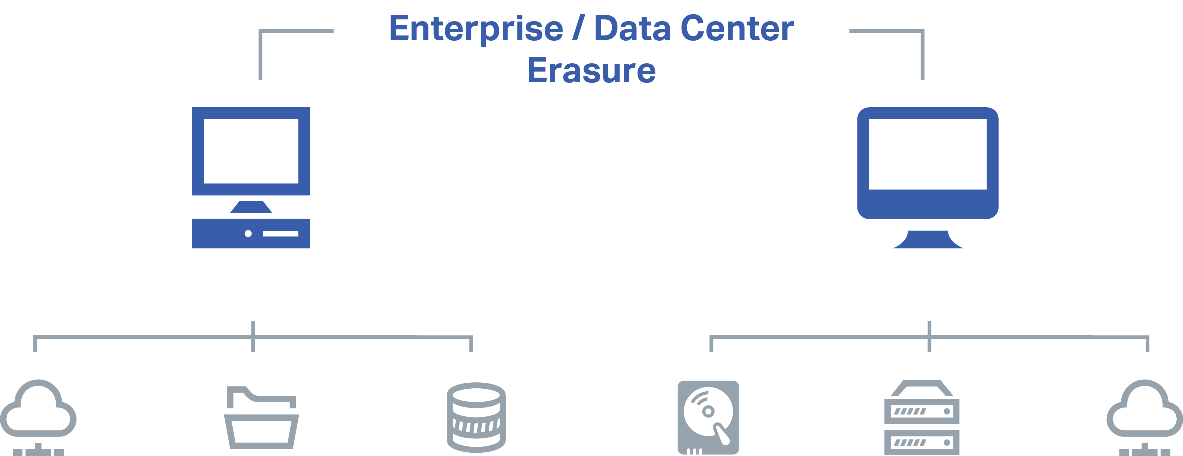
Address Physical & Logical Erasure Needs with Blancco Solutions
Logical Erasure
Physical Erasure
Blancco LUN Eraser*
(LUNs, virtual, clusters, files)
Blancco
File Eraser
Blancco Virtual Machine Eraser
Blancco
Drive Eraser
Blancco Hardware
Blancco LUN Eraser* (erase on top of existing OS, fallback when drive/server not supported by Blancco DE)
Notes:
*Blancco LUN has both logical and physical use cases.
**Any time there is not a full erasure- we recommend doing a free disk space erasure with Blancco File
For LUN Eraser for physical – look for key phrases from customer – “Atom”, “Surface erasure”

Slide 8



Blancco Data Erasure Solutions Overview
Software
Use across data center sites
Hardware
Various solutions to meet unique needs
Support
Dedicated Support
team
Professional Services
Services to
ensure success
Blancco Management Console
Blancco Drive Eraser
Blancco LUN Eraser
Enterprise hardware for:
Loose drive RMA Erasure
SAN and Server Erasure
Upfront purchase with
3-year warranty
Blancco’s most advanced support
24x7 phone support
Case routing to Sr. Engineer
Fast response times
KP access, support portal
Ability to draw from pool of services for:
Product training
Implementation assistance
Strategic consulting (i.e. erasure policy, best practices)
System integration

Slide 9
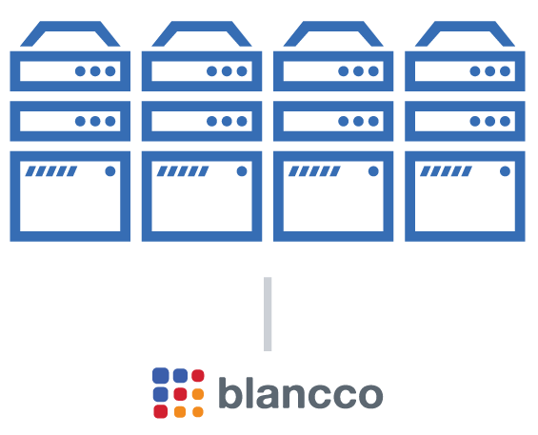
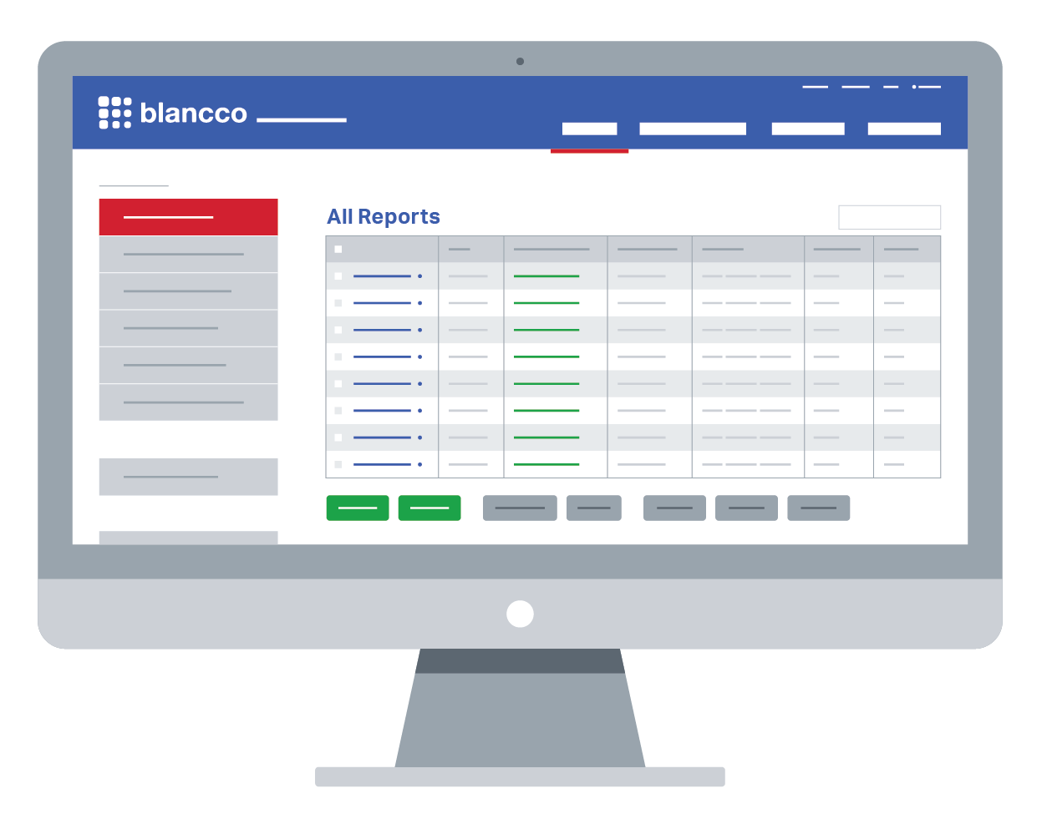
Server Decommissioning – at Scale
Servers are connected to Management Console
Operational Efficiency
Connect, erase and monitor servers across clusters, areas, rooms or locations
Disconnect appliance without stopping erasure in order to move to another batch of up servers to erase
Custom reporting/input fields to enforce process/policy
IT Security
Erase to 25+ overwriting standards
Every single sector of the drive is overwritten and verified to your specifications
Corporate Compliance
Customize reporting to your specific policies and requirements
View, save or share tamper-proof Certificate of Erasure with compliance teams
Erasures initiated remotely
Notes:
Need to understand how they connect the servers to the MC – need to be clear HOW we do this.

Slide 10

Server Decommissioning Example:
4,000 Servers decommissioned overnight
Each server had 6x1TB SATA HDD. Total 24,000 drives
Erasure time was 5-8 hours.
Total time from start (boot up) to finish (report collection): 10 hours
Erasure method was NIST 800-88 Clear
Notes:
Additional example with comments from Dhia

Slide 11
Physical Destruction vs. Data Erasure
Explore the benefits of Blancco’s secure data erasure software over traditional physical destruction methods.
 | Physical Destruction | Blancco Data Erasure Software
Achieves Data Sanitization
Certificate of Erasure for Every Asset, Proving Compliance with 25+ Global Standards
Supports CSR Initiatives
Secure Chain of Custody
Patented Technology, Providing 100% Sanitization of SSDs
Erase Data in Live Environments with No Downtime
Cost-Effective Method
API Integration with Existing Enterprise Systems
Assets Can be Reused, Resold or Donated

Slide 12



Our Strengths
Certified Technical Engineers
Ongoing Maintenance & Support
Research &
Development
Certified &
Tested
Install and configure your solution across devices
Train your staff either onsite or remotely
Develop automated erasure processes for erasure and set up integrations via our REST API
Provide you with the experience and expertise to comply with the most challenging regulations
Access to our support portal; remote support available
Problem-solving assistance via phone, support portal or email with one of our product experts
Ability to provide direct feedback to our support team
A dedicated technical account manager* who will provide proactive planning and technical reviews,, escalate issues and more
We invest heavily in our R&D budget each year to remain the market leader
We offer the most comprehensive erasure solutions on the market today
We have over 30 patented or patent-pending technologies
We keep pace with the latest innovations and regulatory requirements – so you don’t have to
Support 25+ certified erasure methods in our applications
Comply with all relevant NIST sanitization guidelines, including meeting purge requirements for drive erasure
Have been tested, certified, approved and recommended by 15+ governing bodies around the world
Comply with the most rigorous requirements set by government agencies, legal authorities and independent testing laboratories
Notes:
So how we are different than our competitors? Beyond our software, we provided added benefits to our customers. This include our certified engineer team, our support, our research and our certifications. We invest heavily in these four areas to ensure we stay up-to-date with the latest technologies, we test our products via 3rd party testing and work with federal regulations to ensure we meet their standards in data erasure.
And we say we invest – we do. Technology is moving fast – and our clients don’t have the time or resources to stay on top of it all. They lean on us to do that. That’s why we have a major focus on R&D.

Slide 13

“As a Datacenter and Cloud solution provider, Telehouse is committed to providing strong guaranty to its customer. We chose a software-based data erasure process as irrefutable evidence that we comply with EU regulations when erasing customer data.
More than a technical solution, the software erasure process allows us to deliver TRUST to our customers. This is the most valuable asset in our business field, on top of providing strong evidence for our security certifications like ISO 27001 or PCI DSS”.
– Benoît Mercier, Directeur ICT Solutions, Telehouse Europe

